Slide 1
I2P(I) Final Practice
14166 - Doraemon's dorayaki

Slide 2

Description
Doraemon aims to make a fortune from the significant daily price changes of dorayaki. He plans to buy dorayaki on one day and sell it on another to profit from the price spread. To keep his plans secret, Doraemon will only hold one dorayaki at a time, meaning he must sell each one before buying another.
Given the dorayaki prices over a continuous span of N days, please calculate the maximum profit Doraemon can gain.

Slide 3
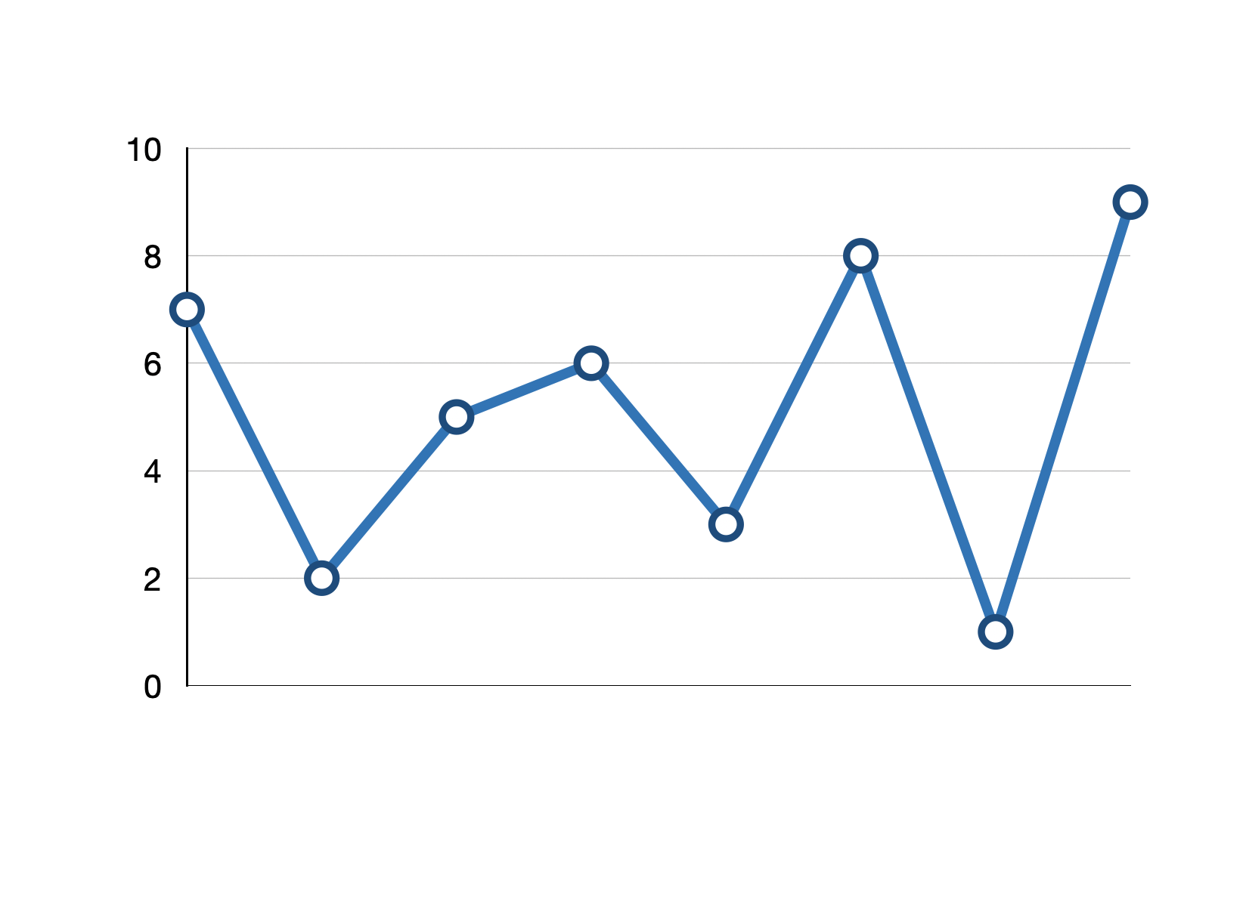
Description
Choose the right times to buy and sell dorayaki to profit from the price spread. The number of transactions (buying and selling) is unlimited, what is the maximum profit that can be gained given price points?

Slide 4
Idea 1: Recursion
Use recursion to enumerate all kinds of ways to conduct transactions.
Return the maximum profit that can be gained.

Slide 5
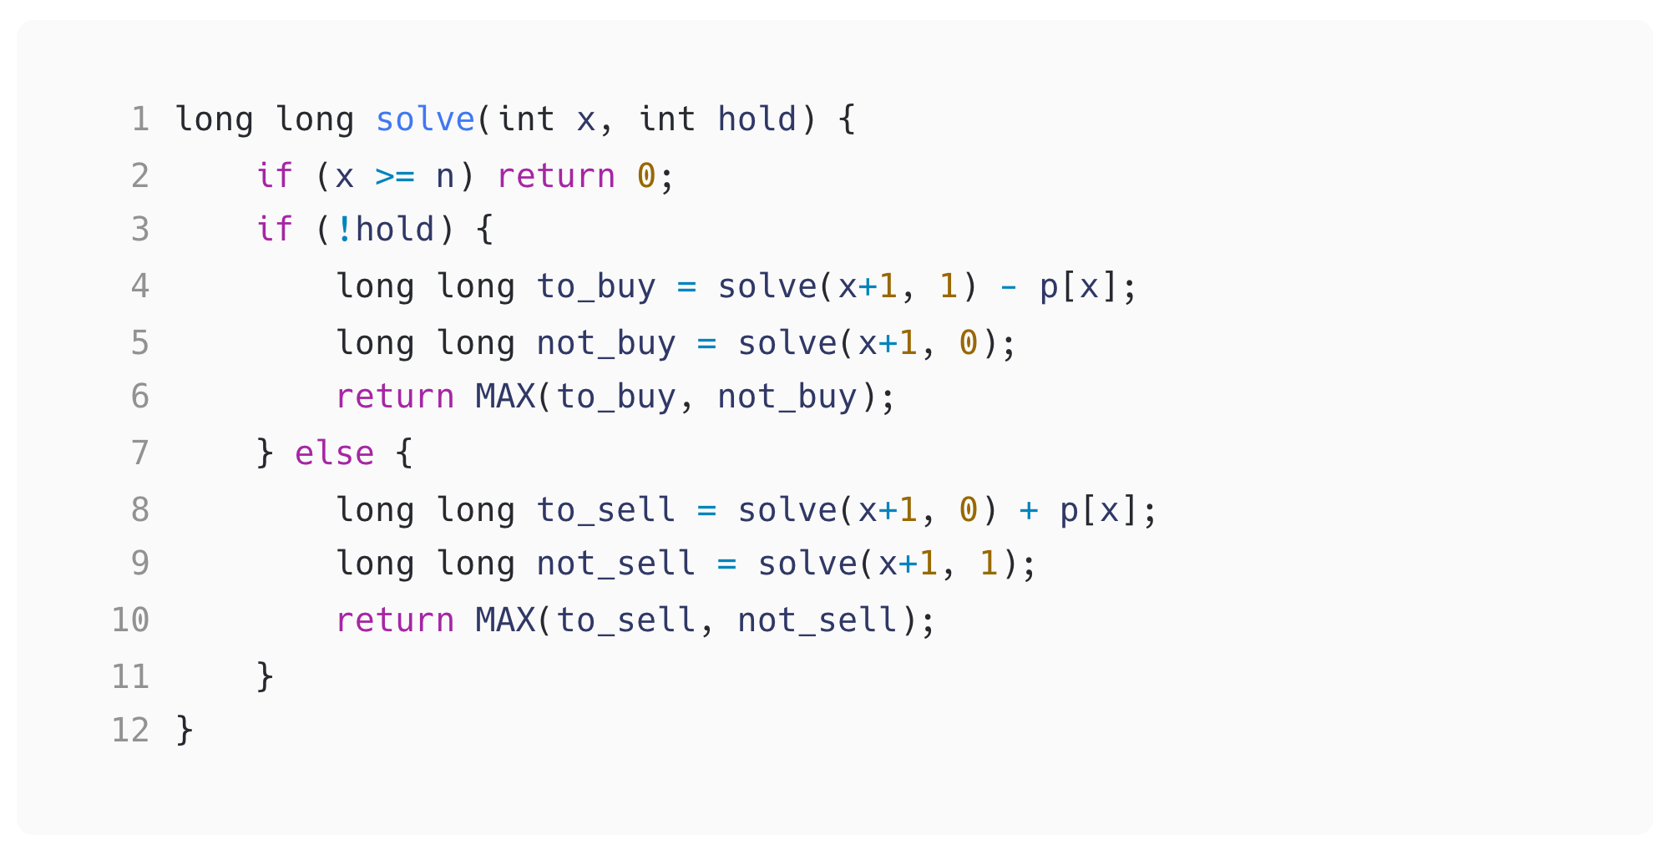
price point 0
0,0
buy
!buy
Idea 1: Recursion
price point 1
1,1
1,0
sell
!sell
buy
!buy
.
.
.
2,0
2,1
2,1
2,0
Function solve(x, hold)
x
represents the index of the
currently considered price.
hold
represents if it is currently
holding an item (involved
in a transaction) or not.
solve(0, 0) -> Returning the
max profit that can be gained,
starting from the 0-th price point
and not holding an item.
. . .

Slide 6
Idea 1: Recursion
to_buy
Not currently holding an item
and to buy using the x-th price point
not_buy
Not currently holding an item
and not to buy using the x-th price point

Slide 7
Idea 1: Recursion
to_sell
Currently involved in a transaction
and to sell using the x-th price point
not_sell
Currently involved in a transaction
and not to sell using the x-th price point

Slide 8
Idea 1: Recursion
Sample Code Link
However, this is too slow for N <= 10^5.

Slide 9
Idea 2: Memorization
Try to calculate the maximum profit for all the price points.
Record the profit at each price point for both states:
“holding an item” and “not holding an item” (involved in a transaction or not)

Slide 10
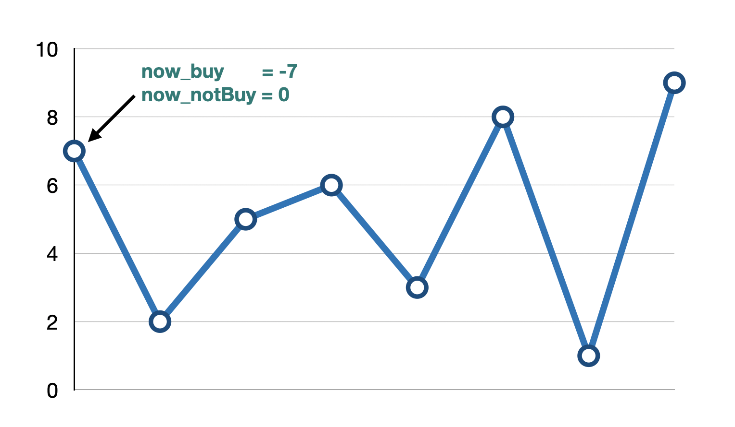
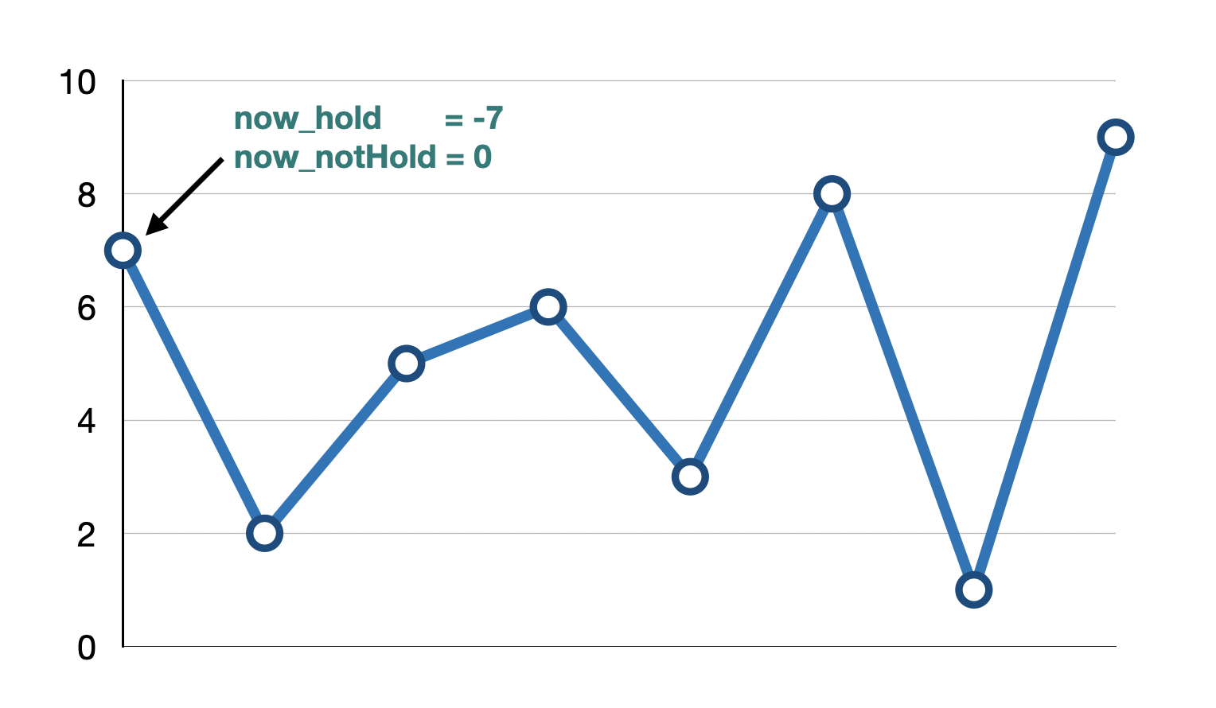
Idea 2: Memorization
now_hold: max profit achievable when currently holding an item.
now_notHold: max profit achievable when currently not holding an item.
now_hold = max(prev_hold, prev_notHold – price[x])
now_notHold = max(prev_notHold, prev_hold + price[x])

Slide 11
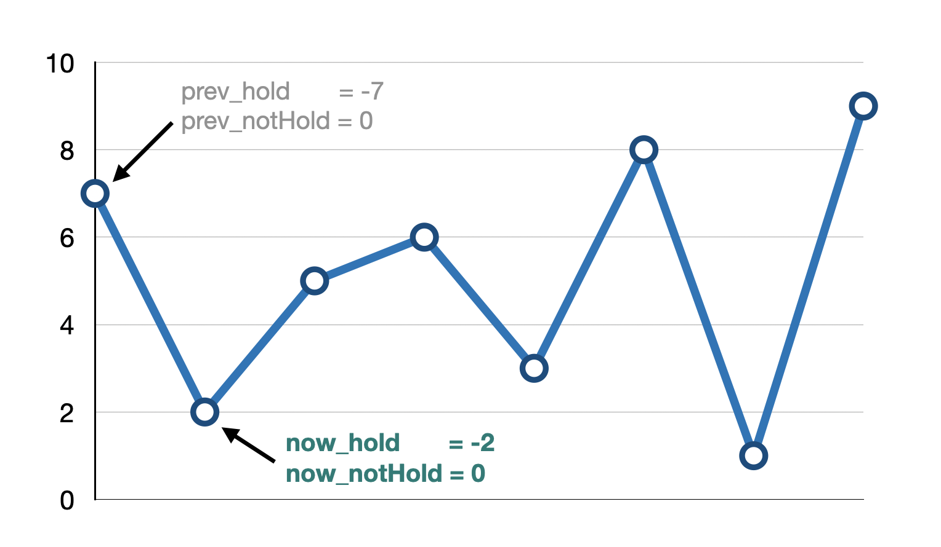
Idea 2: Memorization
now_hold: max profit achievable when currently holding an item.
now_notHold: max profit achievable when currently not holding an item.
now_hold = max(prev_hold, prev_notHold – price[x])
now_notHold = max(prev_notHold, prev_hold + price[x])

Slide 12
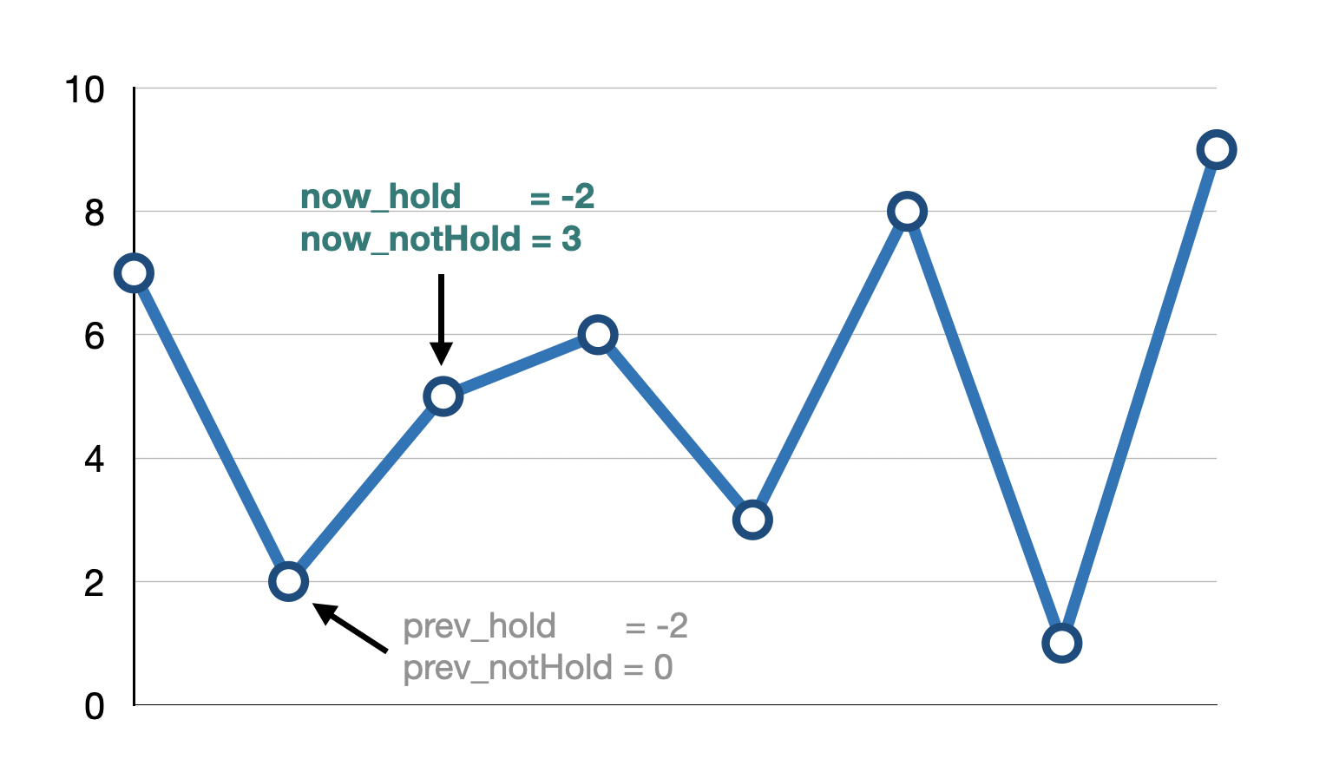
Idea 2: Memorization
now_hold: max profit achievable when currently holding an item.
now_notHold: max profit achievable when currently not holding an item.
now_hold = max(prev_hold, prev_notHold – price[x])
now_notHold = max(prev_notHold, prev_hold + price[x])

Slide 13
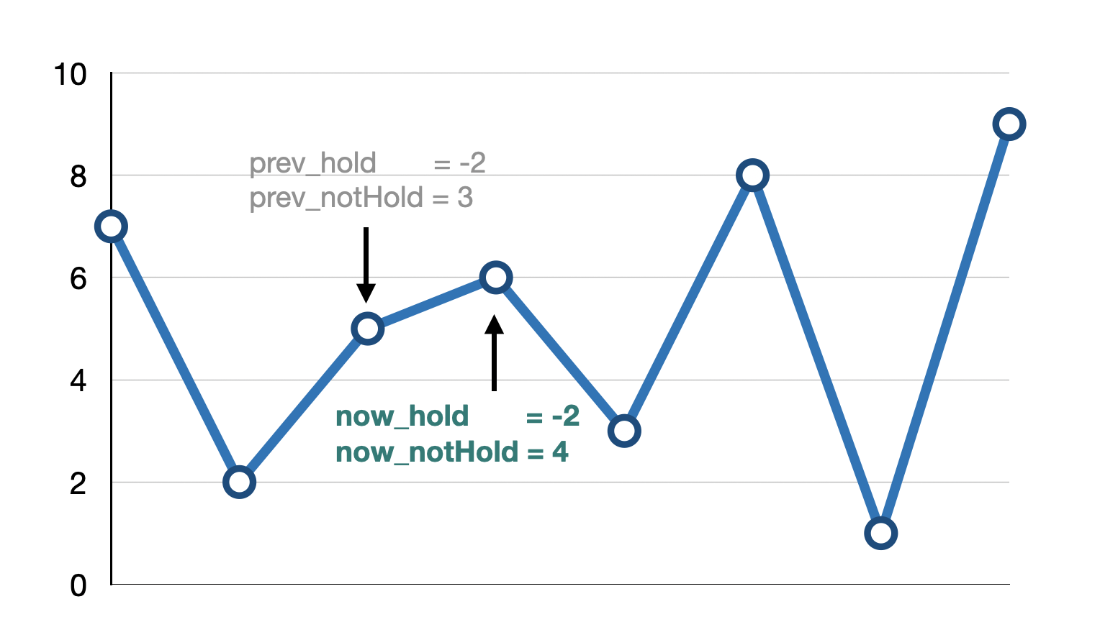
Idea 2: Memorization
now_hold: max profit achievable when currently holding an item.
now_notHold: max profit achievable when currently not holding an item.
now_hold = max(prev_hold, prev_notHold – price[x])
now_notHold = max(prev_notHold, prev_hold + price[x])

Slide 14
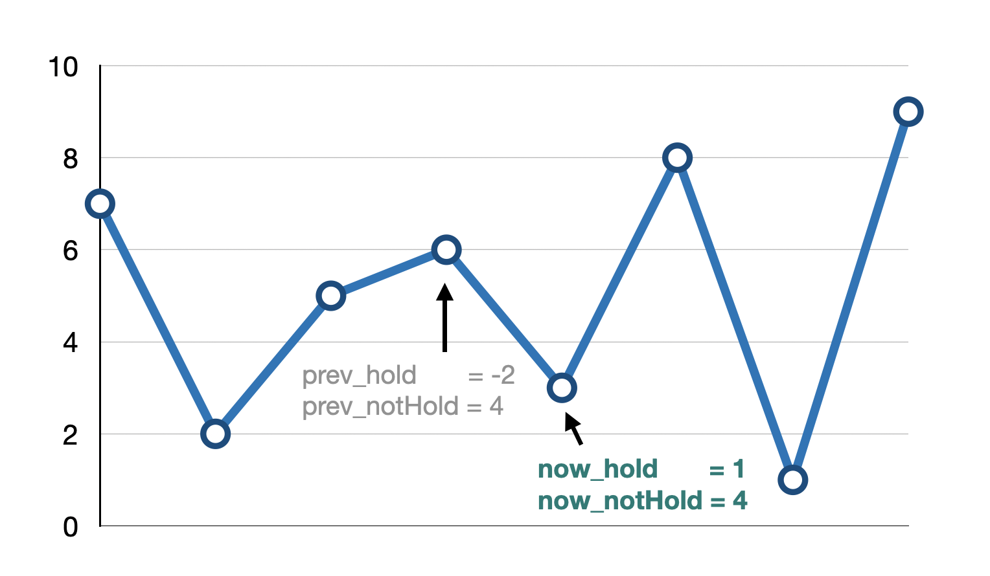
Idea 2: Memorization
now_hold: max profit achievable when currently holding an item.
now_notHold: max profit achievable when currently not holding an item.
now_hold = max(prev_hold, prev_notHold – price[x])
now_notHold = max(prev_notHold, prev_hold + price[x])

Slide 15
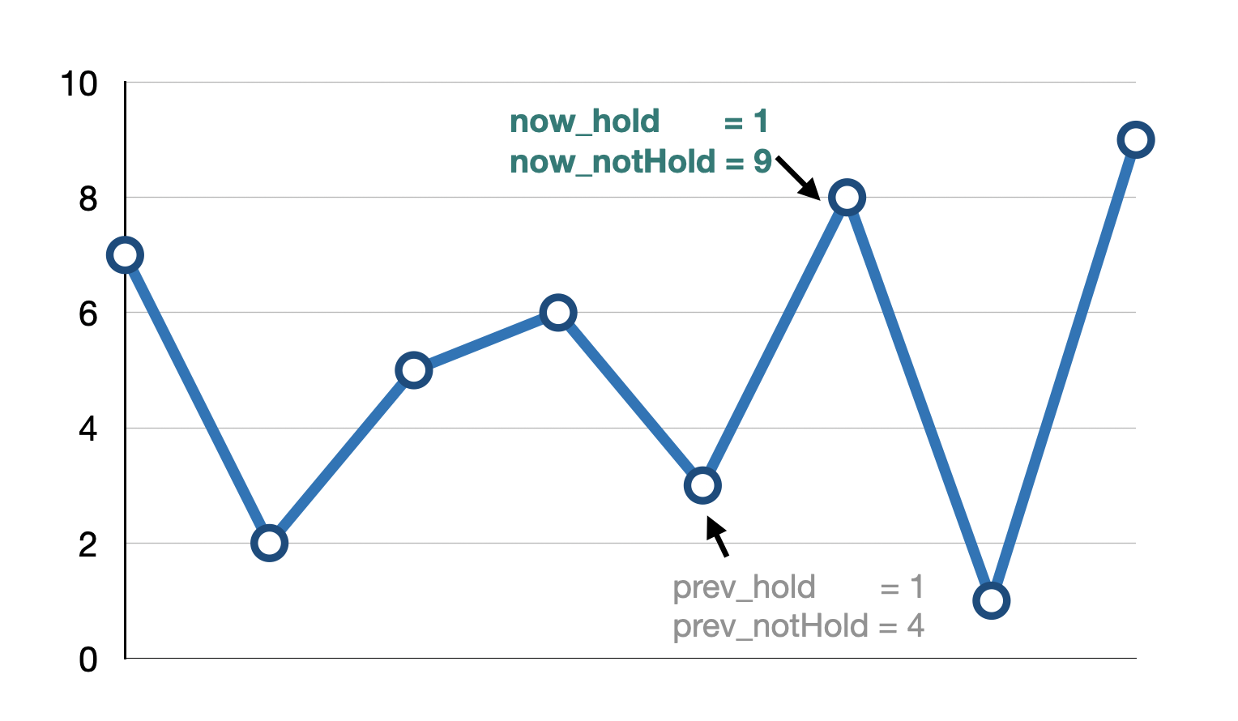
Idea 2: Memorization
now_hold: max profit achievable when currently holding an item.
now_notHold: max profit achievable when currently not holding an item.
now_hold = max(prev_hold, prev_notHold – price[x])
now_notHold = max(prev_notHold, prev_hold + price[x])

Slide 16
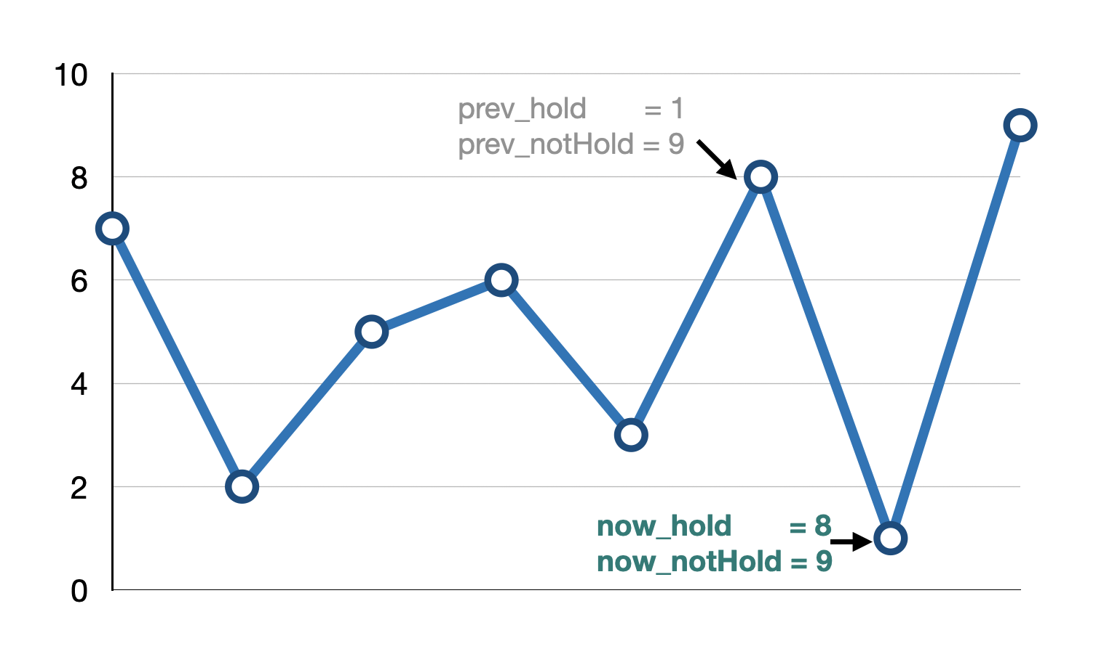
Idea 2: Memorization
now_hold: max profit achievable when currently holding an item.
now_notHold: max profit achievable when currently not holding an item.
now_hold = max(prev_hold, prev_notHold – price[x])
now_notHold = max(prev_notHold, prev_hold + price[x])

Slide 17
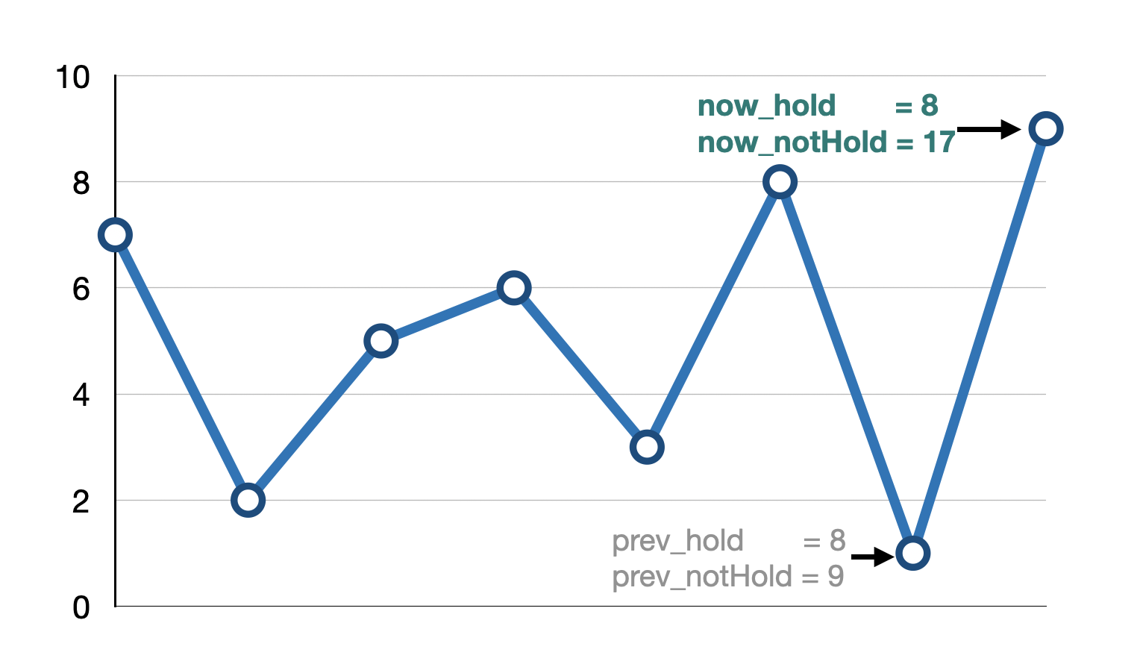
Idea 2: Memorization
now_hold: max profit achievable when currently holding an item.
now_notHold: max profit achievable when currently not holding an item.
now_hold = max(prev_hold, prev_notHold – price[x])
now_notHold = max(prev_notHold, prev_hold + price[x])

Slide 18
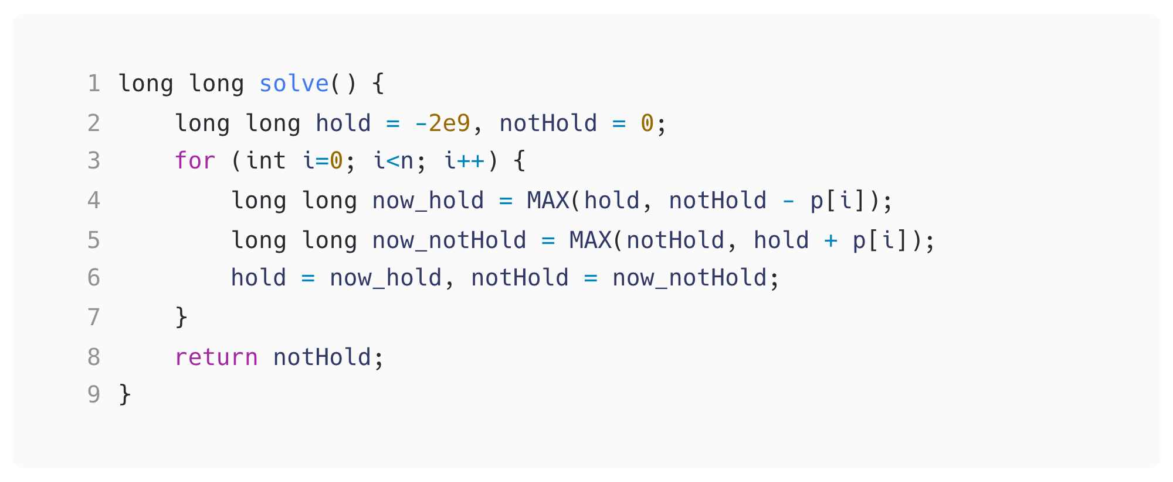
Idea 2: Memorization
hold is initialized as an extremely small number,
since it’s possible to hold an item for the first price point.
Finally, notHold would represent the maximum profit that can be gained.

Slide 19
Idea 2: Memorization
Sample Code Link
Is there any way that is more efficient?

Slide 20
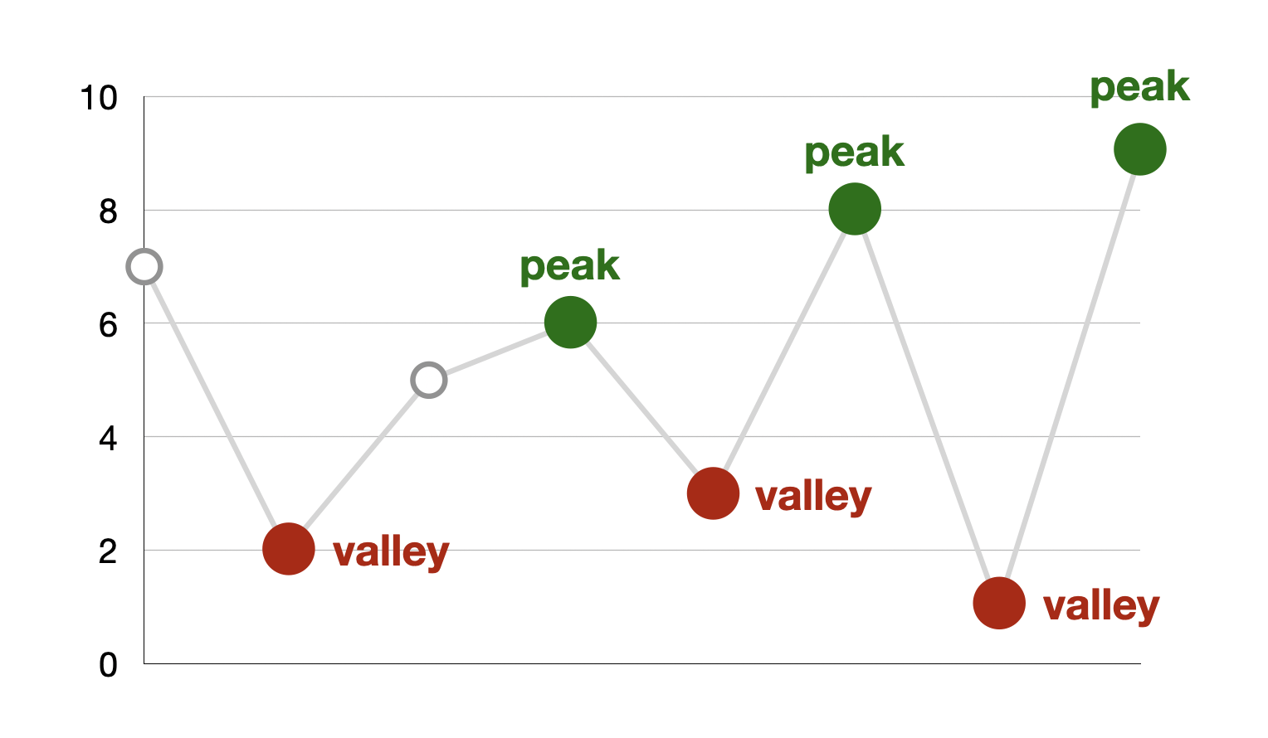
Idea 3: Greedy
Intuitively, we aim to find the lowest point (valley) at which to buy
and the highest point (peak) at which to sell the dorayaki.

Slide 21
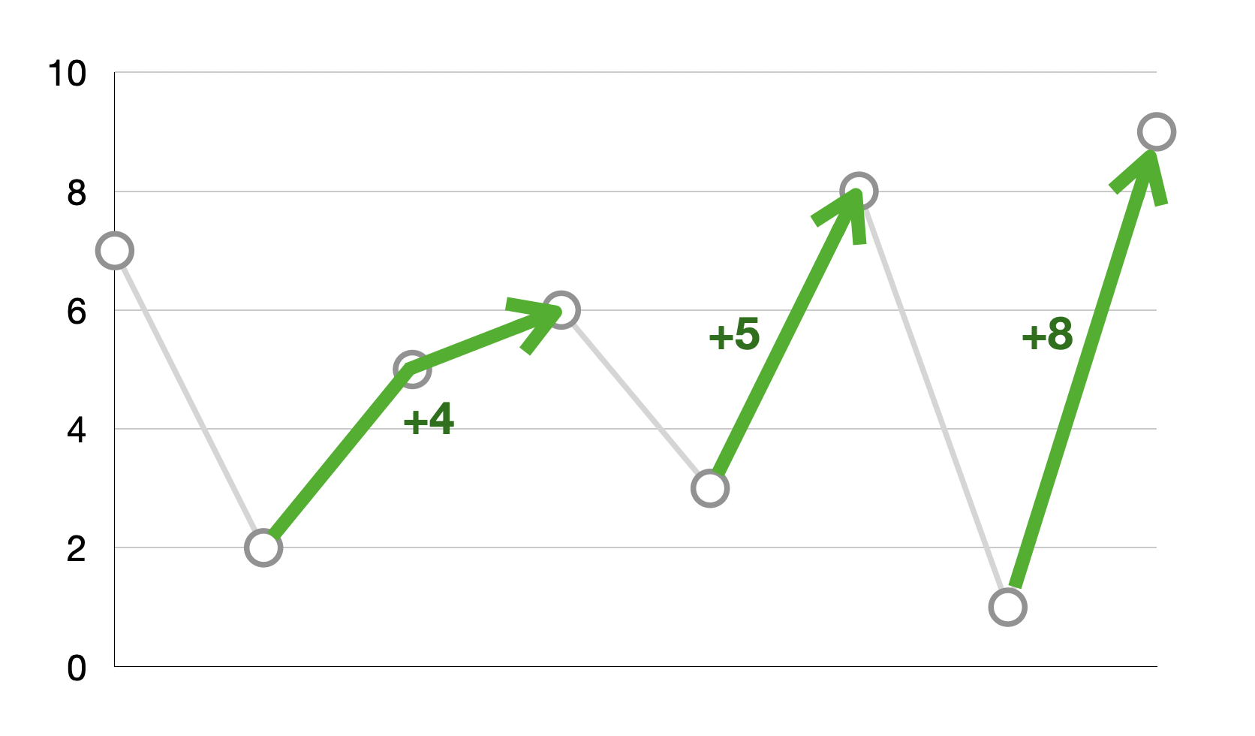
Idea 3: Greedy
Intuitively, we aim to find the lowest point (valley) at which to buy
and the highest point (peak) at which to sell the dorayaki.
After those points are found, we can calculate the profit that can be gained.

Slide 22
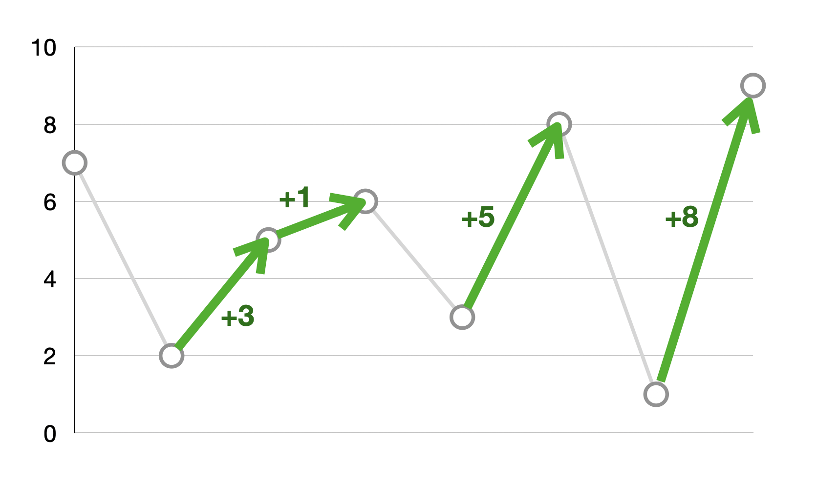
Idea 3: Greedy
However, in the case of continuously climbing prices, we can simply add the difference between prices when the price is rising, like splitting a single transaction into multiple ones.

Slide 23
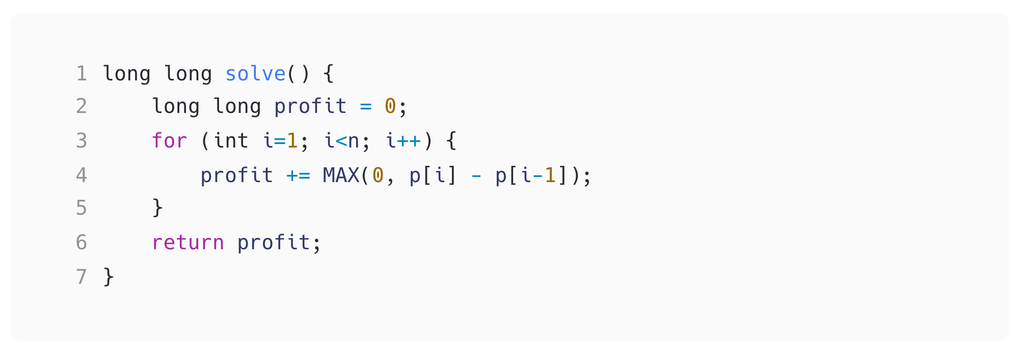
Idea 3: Greedy
In this approach, we always choose the optimal option at each price point, which involves selling when the price rises, ultimately leading to the maximum profit.
We called it a greedy algorithm.

Slide 24
Idea 3: Greedy
Sample Code Link

